Slide 1

How to find your prognosis?
Final project by: Danielle, Degi and Karan

Slide 2
Our Mission
Use machine learning to try and predict a result that you usually have to go to school for 8 years for.

Slide 3
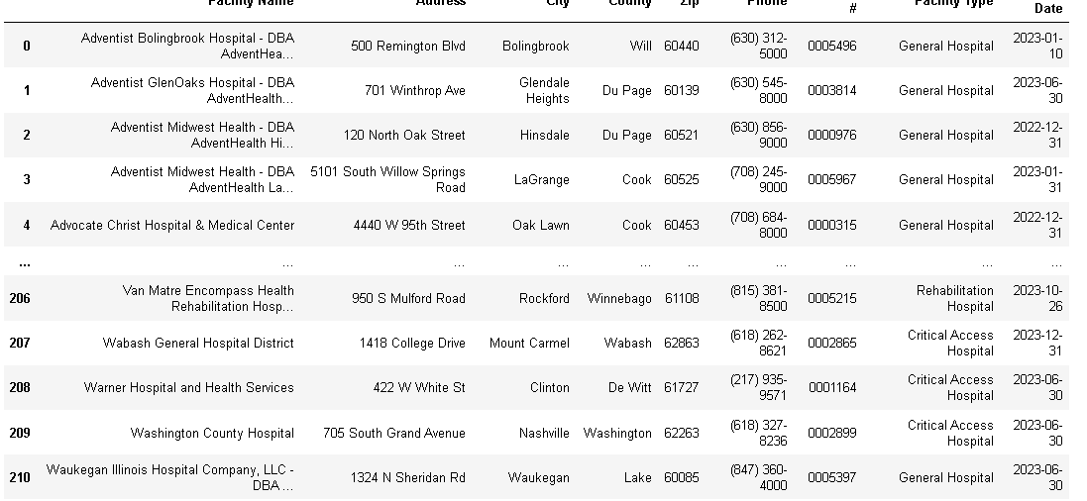
How we started: With Big Datasets and Bigger Dreams.
Starting with our training data:

Slide 4
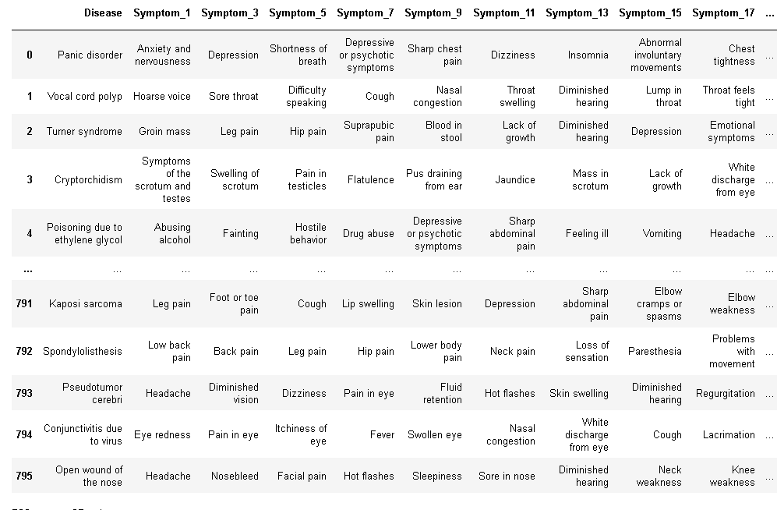
Idea: Chat bot utilizing Disease and over 17 symptoms for every diagnoses coupled with Hospital data. To ask someone to list their symptoms and the bot would output a diagnosis and a medical facility that could help treat the illness.

Slide 5
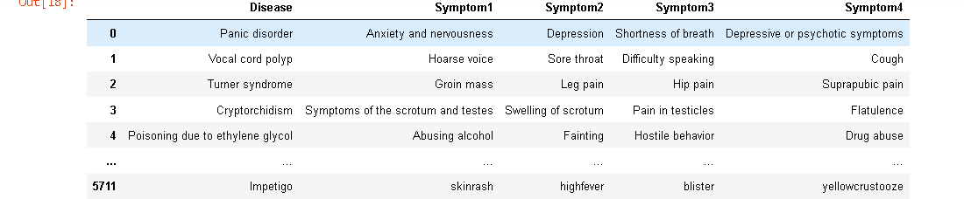
We cleaned until we couldn't but still realized this is moot, and we needed to reevaluate our approach.

Slide 6
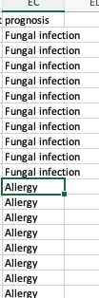
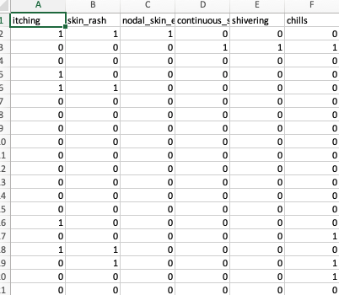
Where we ended:
2 data sets
Training and testing

Slide 7
Preparing to train our model
Checking distribution of data
Using value_counts to compute the number of occurrences of each category in prognosis column.
Data is equally balanced therefore we can deem this as a good data set.
convert labels into numerical format
Here we are converting strings into numerical format.
This needed to be done because we are using going down the classification route and all data needs to be numerical to be processed.
Splitting the data
Training and testing using the iloc method to separate the dataframes
X is all the data besides the last column and Y is only the last column
20% of our data will be used for testing and the remainder for training

Slide 8
Preparing to train continued:
K-fold cross validation?
SVC, Naive bayes and Random forest- best models for classification method
All 3 models were consistent in testing and training.
To visualize this we used a confusion matrix heat map
We saw there were not a high number of false pos. Or false neg. Otherwise this may have made the model 1 sided.

Slide 9
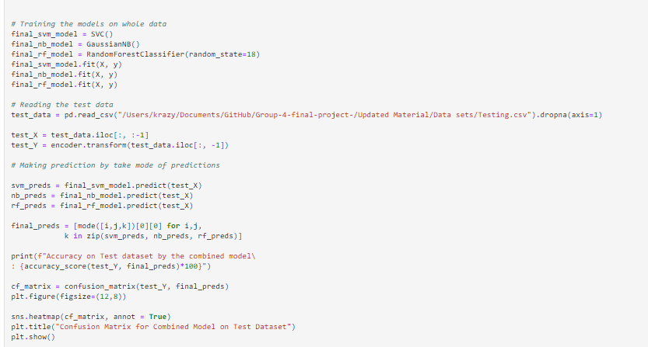

Slide 10
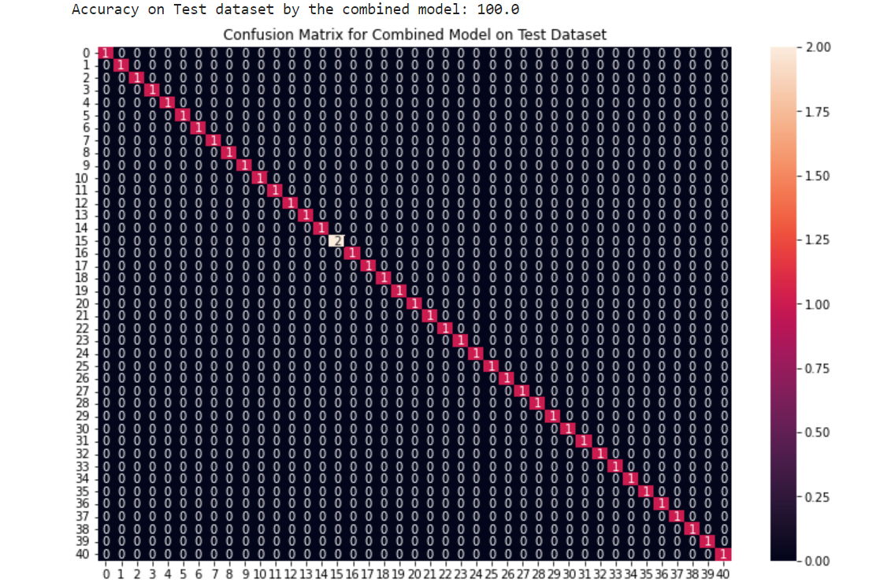
Accuracy on Test dataset by the combined model
We trained three different machine learning models on the same dataset, then uses each of these models to make predictions on a test dataset. The final predictions are made by taking the mode (the most common value) of the predictions made by each of the three models.
The code prints the accuracy of the combined model on the test dataset and displays a confusion matrix to visualize the performance of the model.

Slide 11
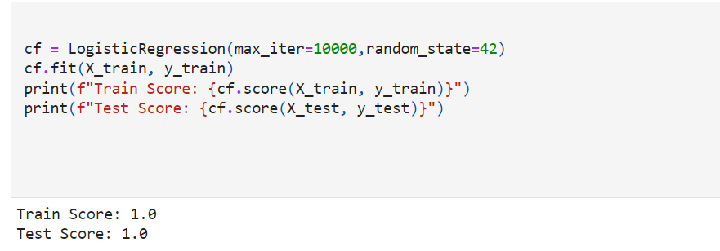
Training a logistic regression model on a dataset split into training and testing sets X_train and X_test, respectively, using the corresponding labels y_train and y_test.
The model is then evaluated by computing the model's accuracy on both the training and testing sets using the score method of the logistic regression model and printing the results.
To evaluate the performance of a machine learning model and ensure that it is not overfitting to the training data.

Slide 12
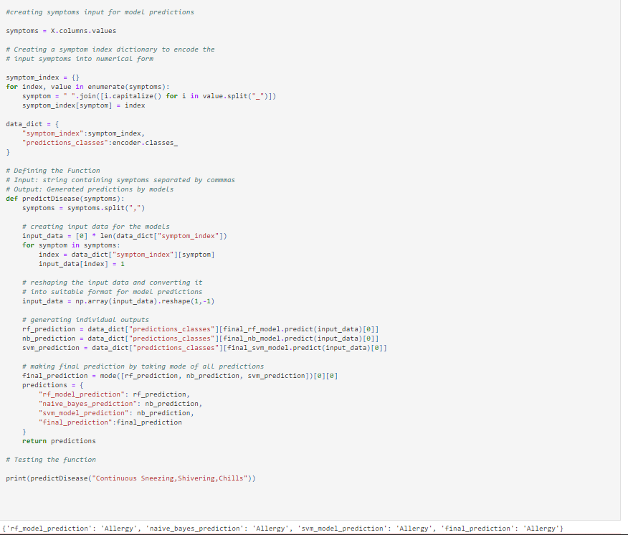
Creating symptoms input for model predictions

Slide 13
Creating symptoms input for model predictions
Defining a function called predictDisease that takes a string containing a list of symptoms as input and returns a dictionary of predictions made by three trained machine learning models (Random Forest, Naive Bayes, and SVM) and a final combined prediction made by taking the mode of the individual model predictions.
The function takes the input string of symptoms, splits it into individual symptoms, encodes the symptoms using a pre-defined symptom index, and uses the trained models to make predictions on the encoded input data. The resulting predictions are then returned in a dictionary.
Then tests the function by calling it with inputs.

Slide 14
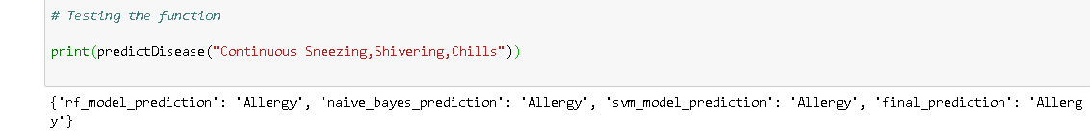
Testing the function- Results

Slide 15
Thank You

